Slide 1

Assessment Feedback (Quiz)

Slide 2
Week 8 Quiz – 5% of overall marks (Quizzes are 20%)

Slide 3
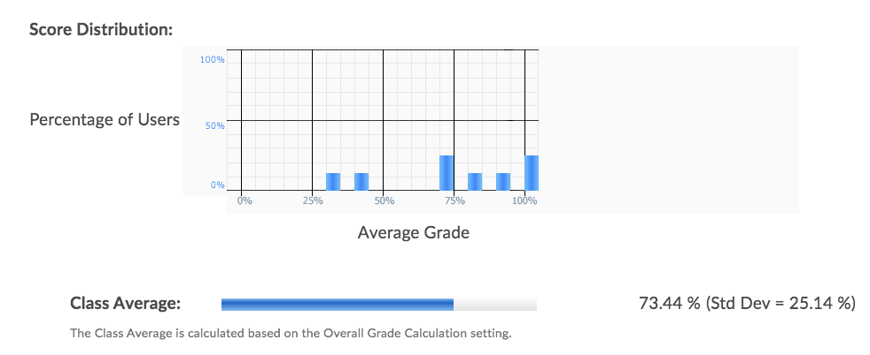
The spread of the grades looked as following:

Slide 4
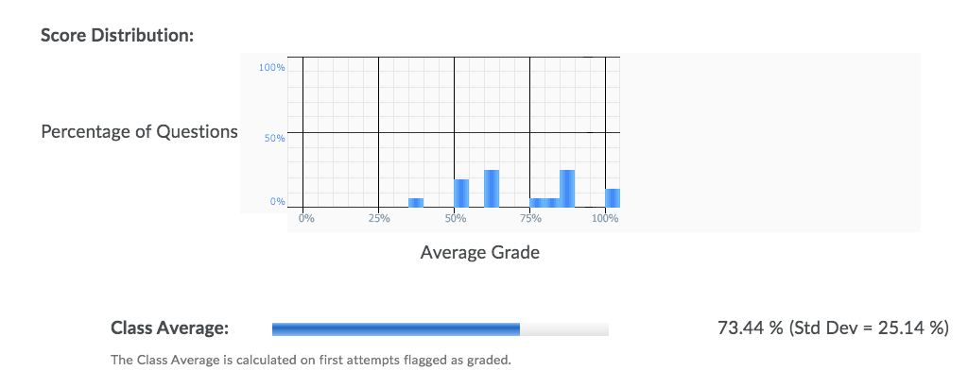
The question statistics looked like this:

Slide 5
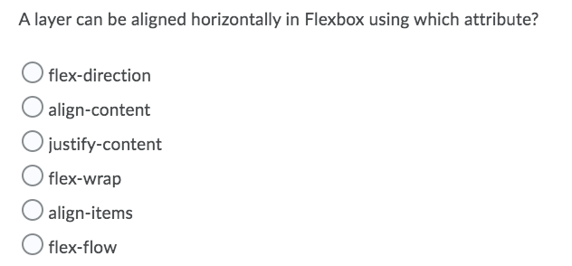
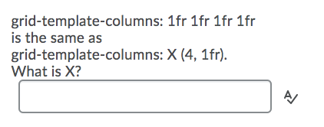
The seven weakest answered questions were..

Slide 6
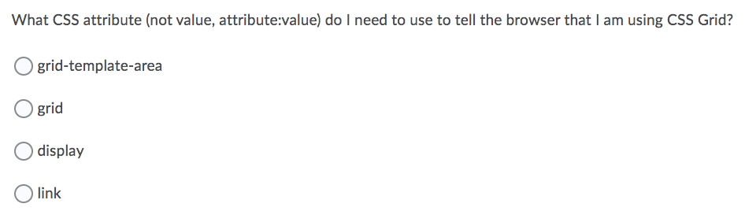
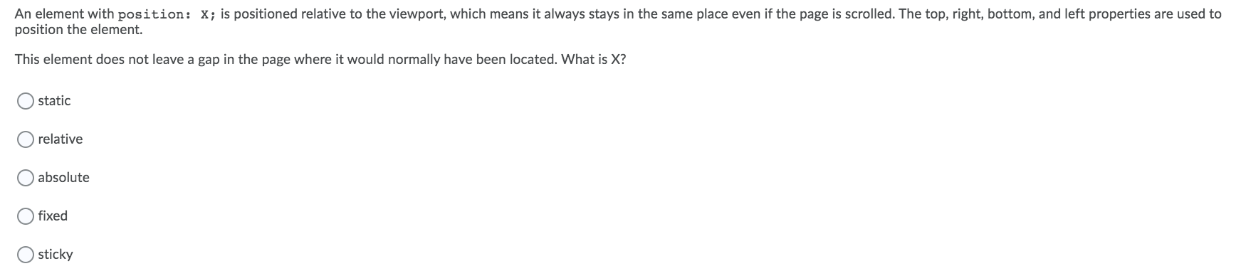
The seven weakest answered questions were..

